Slide 1

AI-Enhanced Medical Imaging and Diagnostic
Team Members
P.Suneel Kumar (Team Leader)
A.Mohan sai
C.Chiranjeevi
E.Vijaya Lakshmi
N.Vinod Kumar
R.Likitha
Y.Chandu

Slide 2
OBJECTIVE
The main objective of this project is to develop an integrated medical AI system that processes and analyzes text, audio, and image inputs to accurately diagnose diseases and recommend treatments. This system leverages various Azure services and advanced technologies to:
Accurately Identify Diseases: Utilize machine learning models and computer vision techniques to detect and diagnose conditions like pneumonia from medical images, text, and audio inputs.
Translate and Process Multilingual Data: Handle and translate user inputs in different languages to ensure accurate disease identification and treatment recommendations.
Enhance Diagnostics and Treatment: Provide precise recommendations for medications, safety precautions, and follow-up care based on the identified condition.
Streamline Workflow: Automate processes such as data processing, image analysis, and text conversion to improve efficiency and reduce manual workload.
Improve Accessibility: Offer advanced diagnostic capabilities and real-time health monitoring, particularly for remote areas or users with limited access to healthcare facilities.

Slide 3
Project Architecture and Workflow
1. Input Processing
Text Input: The text is first cleaned using NLP techniques (e.g., removing stopwords, tokenization) and then translated to English if needed.
Audio Input: The audio is either recorded or provided as a file, converted to text using speech recognition, and then processed similarly to text input.
Image Input: Images are processed using a custom-trained model (pneumonia_detection_model.h5) to detect specific conditions like pneumonia. The result is then cross-referenced with the dataset for further details.
2. Symptom Matching and Disease Identification
The cleaned and translated text is vectorized using TfidfVectorizer, and cosine similarity is calculated between the user input and the dataset's symptoms.
The system identifies the most similar disease based on this similarity score.
3. Disease Information Retrieval
Once a disease is identified, detailed information about the disease (e.g., symptoms, treatment plan, recommended medications) is retrieved from the combined dataset.
If needed, this information is translated back to the user's preferred language.

Slide 4
Project Architecture and Workflow
4. Output
The relevant disease information is formatted and printed in a clear and concise manner, ensuring all critical details are covered.
If no close match is found, the system prompts the user to try different symptoms.

Slide 5
Module: pyaudio
Classes Used:
pyaudio.PyAudio
pyaudio.Stream
Module: pydub
Class Used: AudioSegment
Module: speech_recognition
Class Used: Recognizer
Function Used: recognize_google
Module: opencv-python (cv2)
Function Used: cv2.imread
Module: pytesseract
Function Used: pytesseract.image_to_string
Module: tensorflow.keras
Custom-trained Model: pneumonia_detection_model.h5
Functions Used:
tensorflow.keras.preprocessing import image as keras_image
Function Used: tensorflow.keras.models.load_model
Module: sklearn.metrics.pairwise
Function Used: cosine_similarity
Module: pandas
Functions Used: pd.read_csv
Technologies Used
Natural Language Processing (NLP)
Audio Processing
Image Processing and Computer Vision
Machine Learning
Data Handling
Module and Functions Used
Module: nltk (Natural Language Toolkit)
Functions Used:
nltk.word_tokenize
nltk.corpus.stopwords
Module: sklearn.feature_extraction.text
Function Used: TfidfVectorizer
Module: langdetect
Function Used: detect
Module: deep_translator
Class Used: google translator

Slide 6
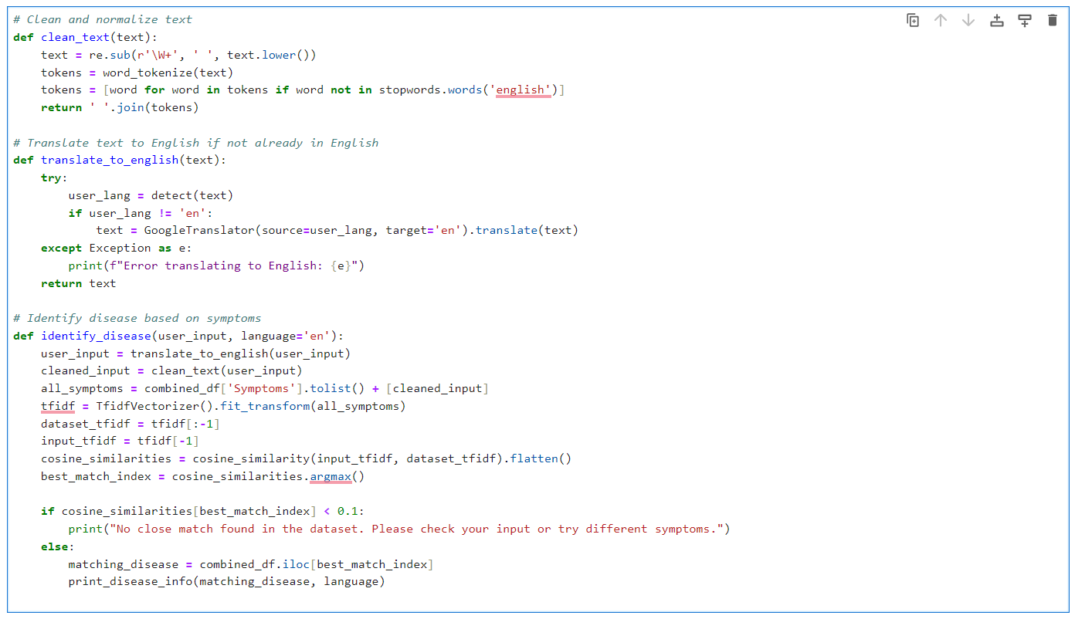
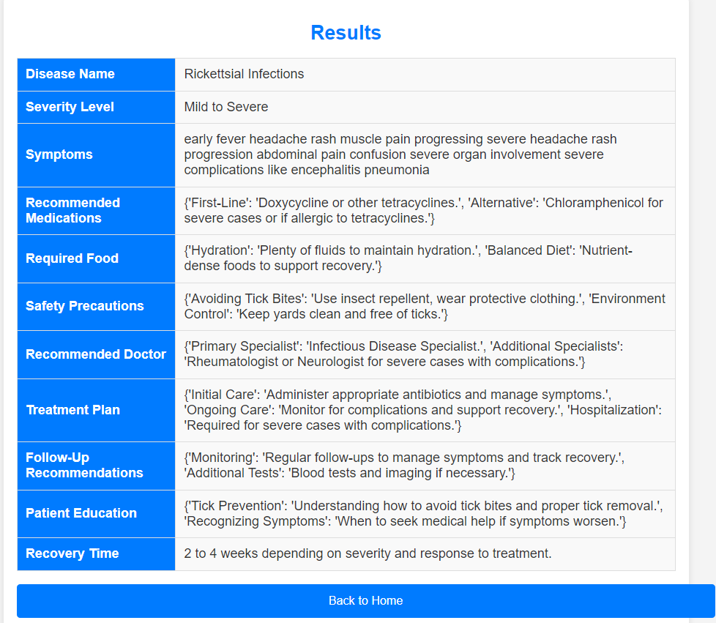
1. Text Processing and Disease Identification
Actions: Clean the text, detect language, translate if needed, vectorize, compute similarity with dataset, identify disease.
Input: User-provided text or symptom description
Output: Disease information.

Slide 7
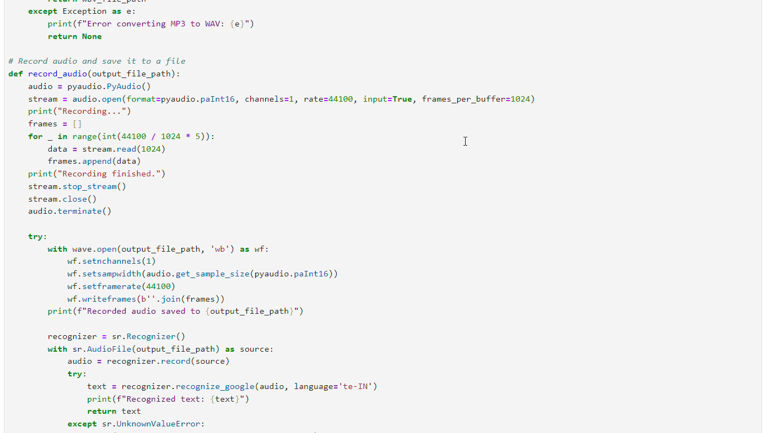
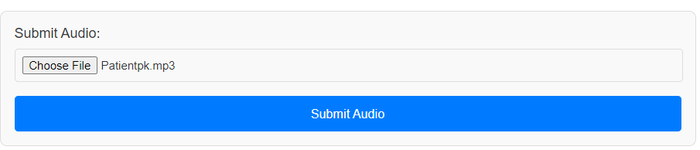
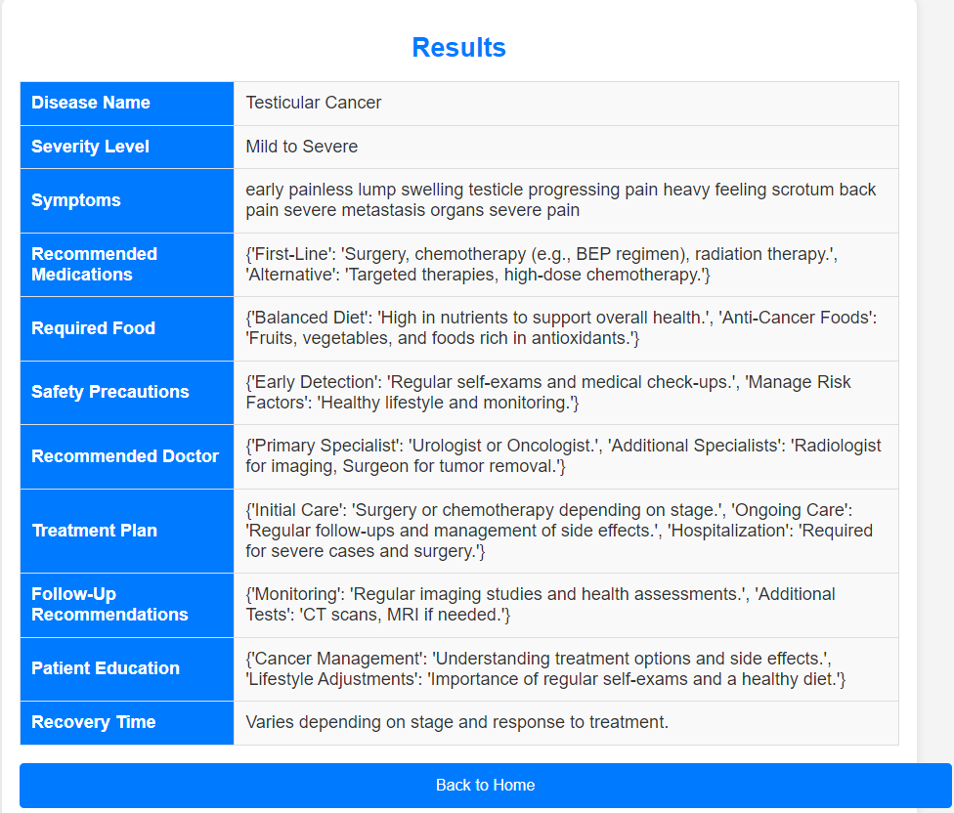
2. Audio Processing and Disease Identification
Actions: Convert MP3 to WAV if needed, recognize speech, translate if needed, process text for disease identification.
Input: Recorded audio or uploaded audio file.
Code snippet
Output: Disease information based on spoken symptoms.

Slide 8
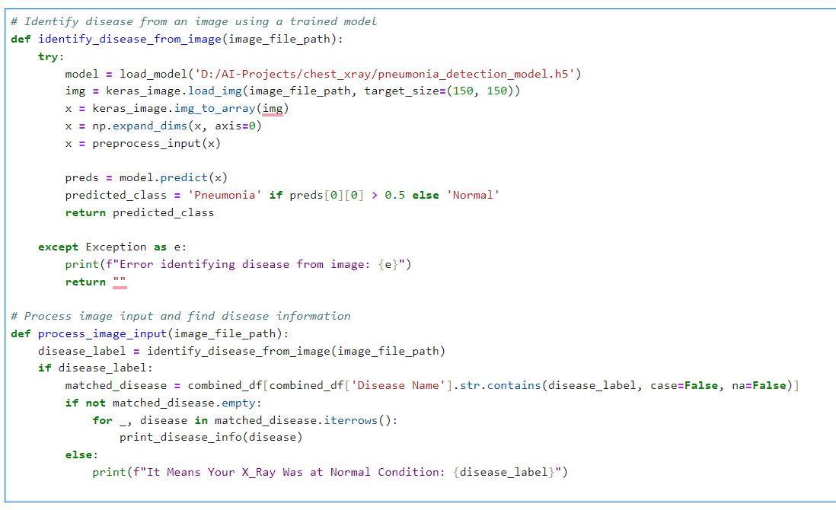

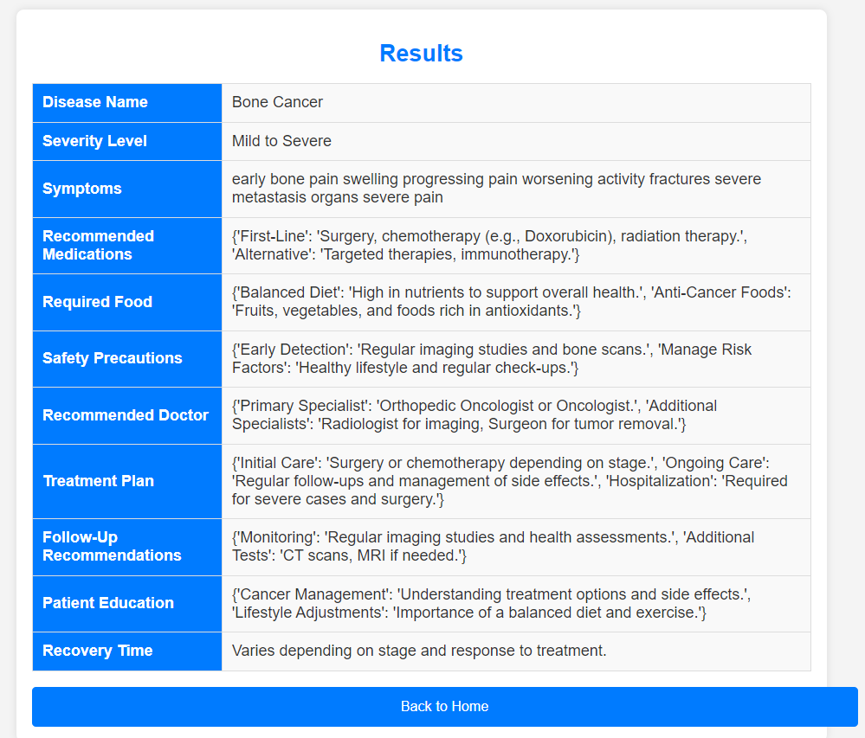
3. Image Processing and Disease Identification
Actions: Load and preprocess image, use trained model to predict disease, match prediction with dataset.
Input: Uploaded image (e.g., X-ray).
Output: Disease information or status.
Code snippet

Slide 9
Challenges Faced !
Data Quality and Integration
Language and Translation Issues
Model Accuracy and Generalization
Processing and Resource Management
User Input Variability
Ethical and Privacy Concerns
Integration with Existing Systems
User Trust and Acceptance

Slide 10
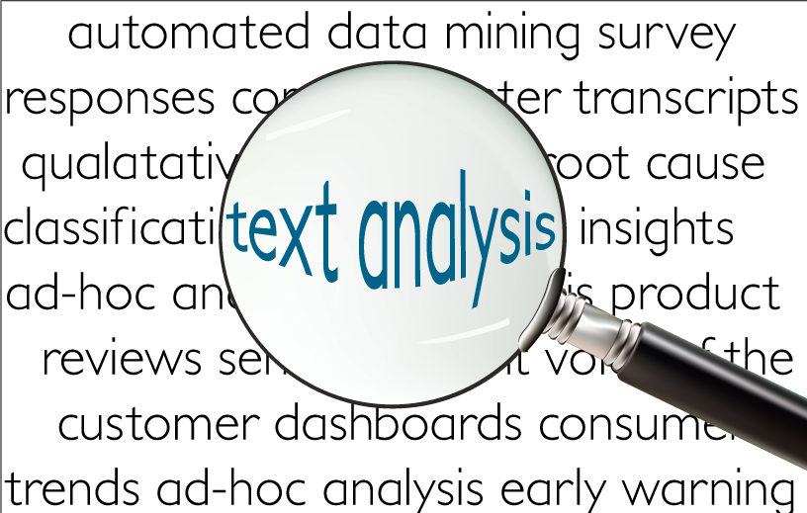
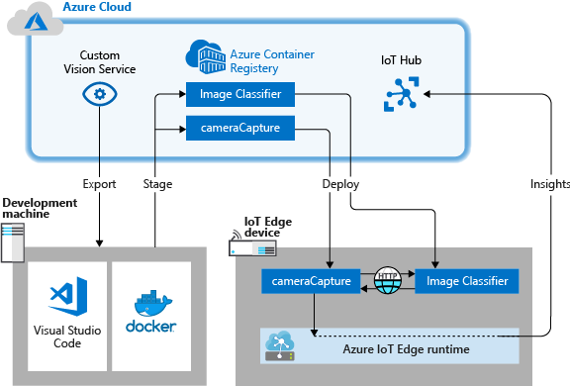
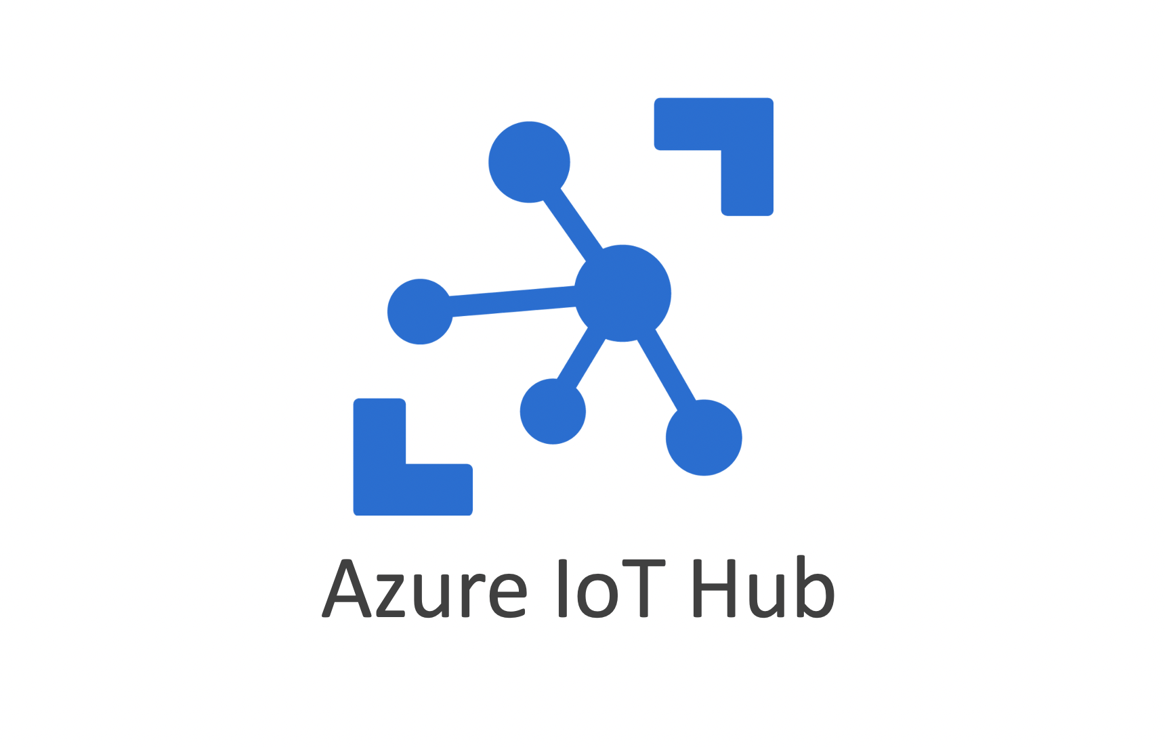
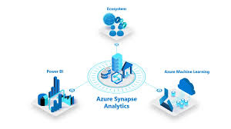
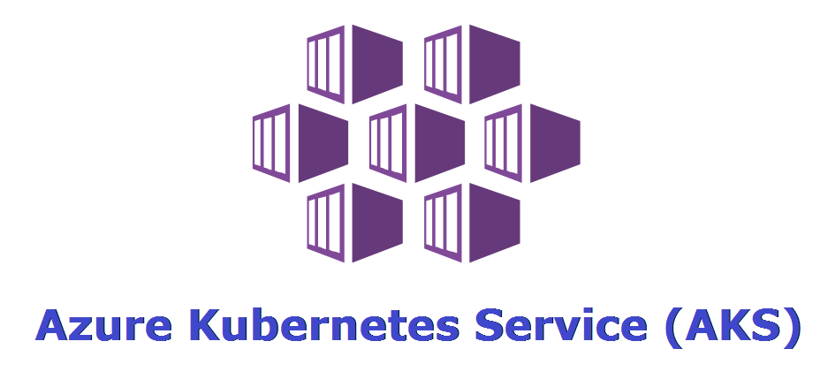
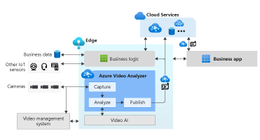
Future Enhance using Azure Services
Text Analytics
Custom Vision
Azure IoT Hub
Azure Synapse Analytics
Azure Video Analyzer
Azure Kubernetes Service

Slide 11



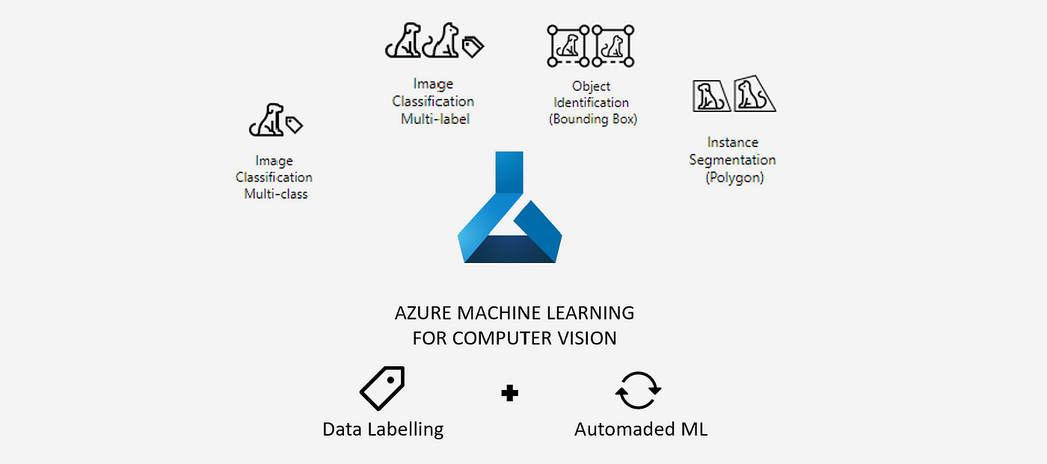


Future Enhance using Azure Services
Azure Blob Storage
Translator
Speech to Text
Azure Machine Learning
Computer Vision
Azure DevOps

Slide 12
Future Enhance using Azure Services
Azure Cognitive Services
Text Analytics: For processing text, detecting languages, translating, and extracting key phrases/entities.
Speech to Text: Converts audio to text, supports multiple languages, and ensures accurate transcription.
Computer Vision: Analyzes images, including OCR and object detection, complementing your image processing tasks.
Custom Vision: Trains and deploys custom models for identifying specific conditions, like pneumonia in X-rays.
Translator: Handles translation to process and analyze user input in various languages.
Azure Machine Learning: Trains, deploys, and manages machine learning models, supporting scalable resources and frameworks like TensorFlow and PyTorch.
Azure Blob Storage: Stores large datasets, audio, video, and images, keeping input data and processed files organized. Azure Functions: Implements serverless workflows, triggering processes like image analysis or text processing based on events (e.g., file uploads).
Azure Video Analyzer: Processes and analyzes video content, extracting frames, analyzing body movements, and detecting abnormalities.

Slide 13
Future Enhansion using Azure Services
Azure Synapse Analytics: Performs large-scale data analysis and visualization, ideal for extensive datasets.
Azure Kubernetes Service (AKS): Deploys and manages containerized applications, helping scale and ensure high availability.
Azure IoT Hub: Manages and analyzes data from IoT devices, useful for integrating wearable devices or sensors for real-time health monitoring.
Azure DevOps: Manages development, testing, and deployment, providing CI/CD pipelines, version control, and project management tools.
Azure Data Factory: Orchestrates data workflows, moving and transforming data across different storage locations or sources.

Slide 14
Future Extension using Azure Services
Data Integration and Analysis
Azure Synapse Analytics: Integrates and analyzes data from multiple sources for comprehensive insights.
Azure Data Factory: Automates ETL processes and complex data workflows, including streaming data integration.
Advanced Machine Learning and AI
Azure Machine Learning: Develops and deploys sophisticated machine learning models with support for AutoML and deep learning techniques.
Azure AI Fundamentals: Adds advanced AI features like anomaly detection and predictive analytics.
Video and Image Analysis
Azure Video Analyzer: Performs real-time video analysis for health monitoring and behavioral detection.
Azure Custom Vision: Customizes image analysis models for detecting a range of medical conditions from various types of images.
Real-Time Monitoring and Alerts
Azure IoT Hub: Integrates IoT devices for real-time health monitoring and data collection.
Azure Stream Analytics: Analyzes real-time data streams and triggers alerts based on predefined conditions.

Slide 15
Future Extension using Azure Services
User Interaction and Personalization
Azure Bot Services: Develops chatbots for personalized patient interactions, scheduling, and health queries.
Azure Personalizer: Provides personalized recommendations and health advice based on user preferences and behavior.
Security and Compliance
Azure Security Center: Manages threat detection and ensures data protection and regulatory compliance.
Azure Key Vault: Secures sensitive data through encryption key management and access control.
Scalability and Deployment
Azure Kubernetes Service (AKS): Deploys and manages containerized applications at scale, ensuring high availability.
Azure Functions: Implements serverless functions for task automation and background processing.
Integration with External Systems
Azure API Management: Manages and integrates APIs with external systems and third-party services for interoperability.
Azure Logic Apps: Automates and integrates workflows across different systems and services.

Slide 16
Why AI-Enhanced Medical Imaging and Diagnostic?
Output parameters provided : Disease Name, Severity Level, Symptoms, Recommended Medications, Required Food, Safety Precautions, Recommended Doctor, Treatment Plan, Follow-Up Recommendations, Patient Education, and Recovery Time.
Improved Accuracy
Early Detection
Efficiency
Personalized Medicine
Cost Reduction
Accessibility
Disease Information

Slide 17
Conclusion
This project leverages cutting-edge AI technology to transform the way we diagnose and manage diseases like pneumonia. By integrating machine learning, natural language processing, and computer vision, it provides a comprehensive solution for analyzing symptoms, processing audio recordings, and interpreting medical images.
The system enhances accuracy by detecting subtle patterns and early signs of disease, improving the chances of successful treatment. It supports multiple languages and automates diagnostic processes, making healthcare more efficient and reducing the workload on medical professionals. Additionally, it ensures faster and more accessible diagnostics, even in remote areas without on-site specialists.
Overall, this project aims to streamline healthcare, provide precise diagnoses, and offer personalized treatment recommendations, ultimately improving patient outcomes and making advanced medical care more widely available.

